Slide 1
Survival / Hazard Analysis
Flight Risk
Zane Harris
April 2016
DRAFT

Slide 2
Problem Statement
Current efforts to decrease voluntary attrition are highly influenced by human bias and could be better informed by data. Managers across the company are not informed on potential flight risk and therefore cannot be proactive in retaining top performers.
The aim of this project is to assign a flight risk probability to existing employees for implementation during FY17.
Efforts would help inform where more advanced methods are not as well accepted.
Employees will be more likely to voluntarily maintain employment when they see incremental salary increases, receive rewards/recognition, and have opportunities to make lateral and promotional movements.
Method / Approach
Target/outcome:
Employment Status (0=active employee, 1=terminated)
Will interpret for “survival” and will right censor the data
Model:
Survival / Hazard Regression
Employees will be more likely to voluntarily maintain employment when they see incremental salary increases, receive rewards/recognition, and have opportunities to make lateral and promotional movements.
Notes:
Talk about what my data looks like (unique id by employee, currently in a few databases oracle, peoplesoft, etc. and a Hadoop cluster will be set up soon)
Internal job application without success
Local area unemployment rates, but there’s a catch – location data is spotty, we have over 50% remote employees and many do not clarify their exact location
We also have employees in over 80 countries so data for many won’t be available, don’t want to build too centrally on that
Neural net

Slide 3

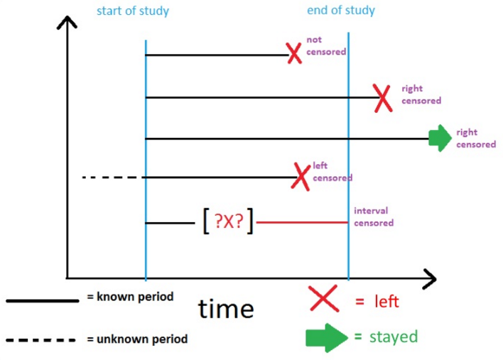
Survival analysis was originally developed and applied heavily by the actuarial and medical community. Its purpose was to answer *why do events occur now versus later* under uncertainty (where *events* might refer to deaths, disease remission, etc.). This is great for researchers who are interested in measuring lifetimes or durations for particular events and subjects: they can answer questions like *what factors might influence deaths?* Examples outside of medicine and actuarial science include research by marketers into “time until first behavior” and sociologists into the lifetimes of political parties. Generation of conditional probabilities (the “hazard rate”) that an employee will quit during a given time.
What is Survival Analysis?
Why not traditional methods?
Cross-sectional approaches treat stayers and leavers incorrectly. End of study? Well 10 days and 10 years are treated the same as that approach can’t differentiate.
Survival / Hazard analysis accounts for time to event better than traditional regression methods and allows for control when the outcome of existing data is unknown. For instance, actively hired employees will leave, but when? This method allows for the use of terminated employee data and active employee data simultaneously through what is known as “right censoring” the data.

Slide 4
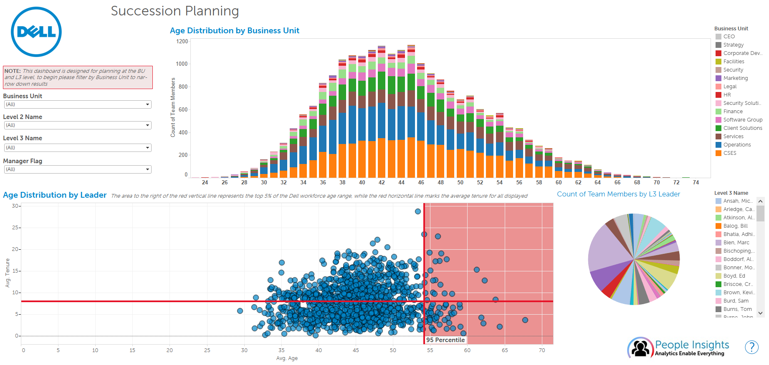
Use of Survival Probability

Slide 5
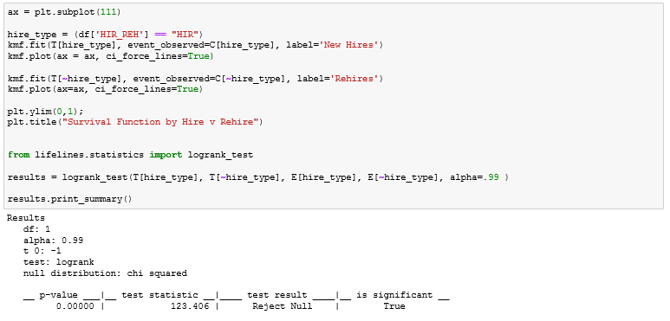
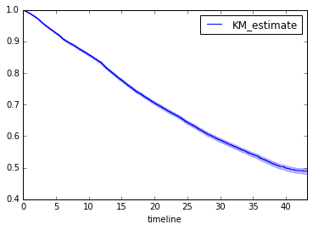
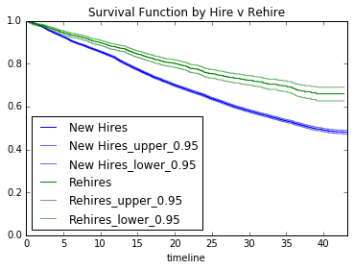
Survival Probability by Months Employed
Kaplan Meier function from the Lifelines Package

Slide 6
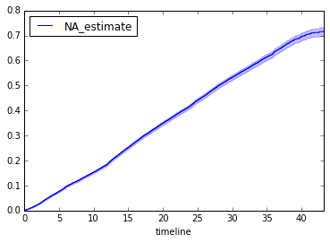
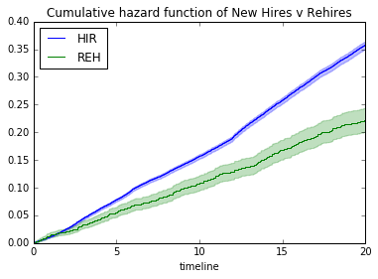
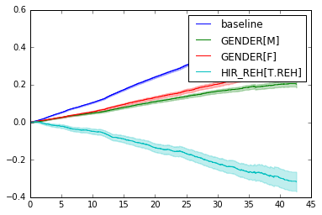
Cumulative Hazard Function
The Cumulative Hazard Function is more focused on the contribution of certain risk factors to a subjects “hazard” or lack of survival.
Nelson Additive Fitter from Lifelines

Slide 7
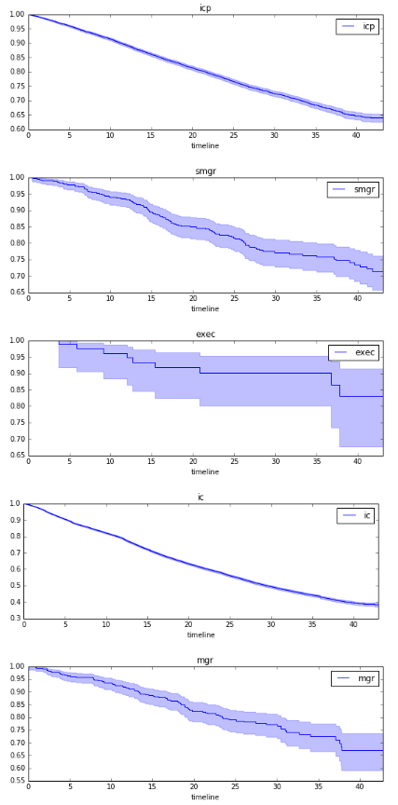
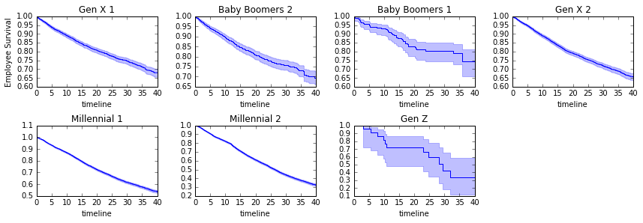
Variations in Risk by Job Level and Generation
In general, older employees had greater survival probability, a phenomenon that we have recognized as younger employees generally have a lower average tenure.
Individual contributors have the worst survival probability, again we have seen this. These roles range from call center jobs to support services in India. Tenures are traditionally low.

Slide 8
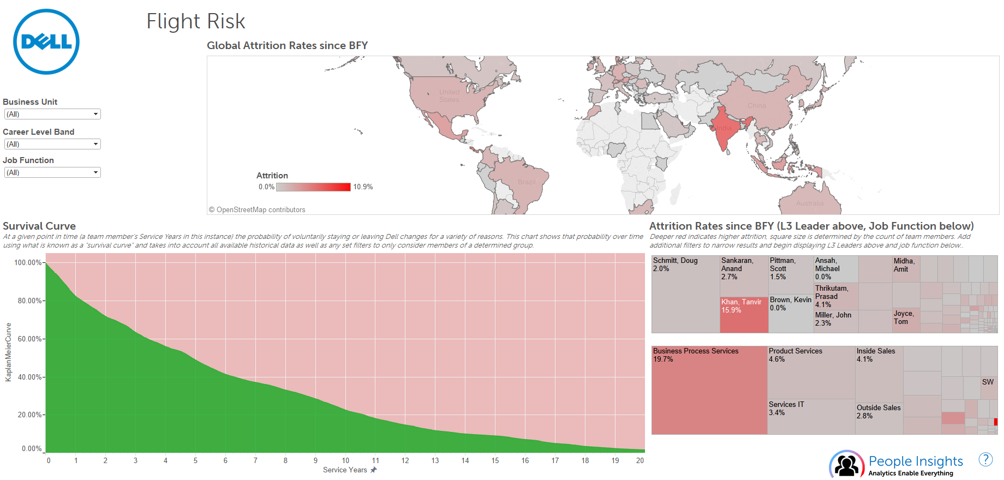
Implementation

Slide 9
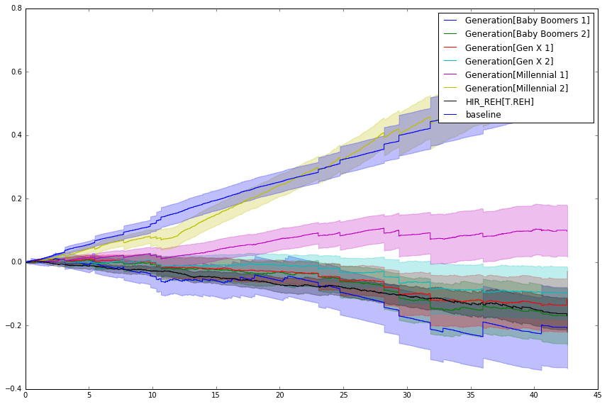
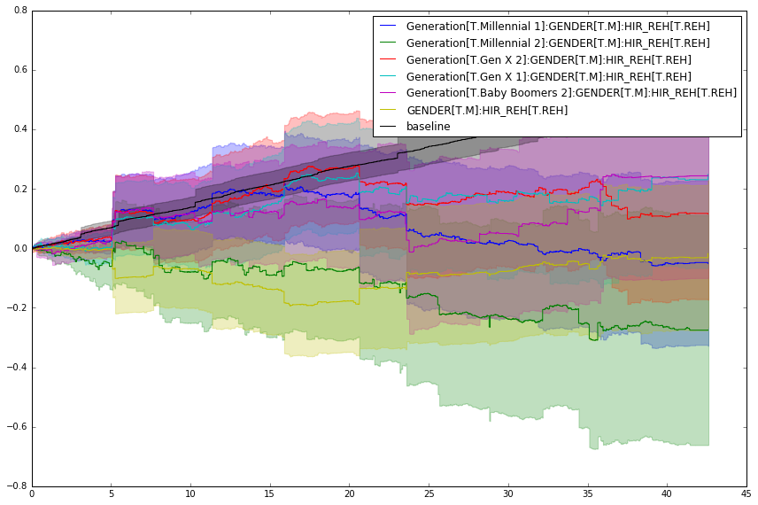
Next Steps: Interactions

Slide 10
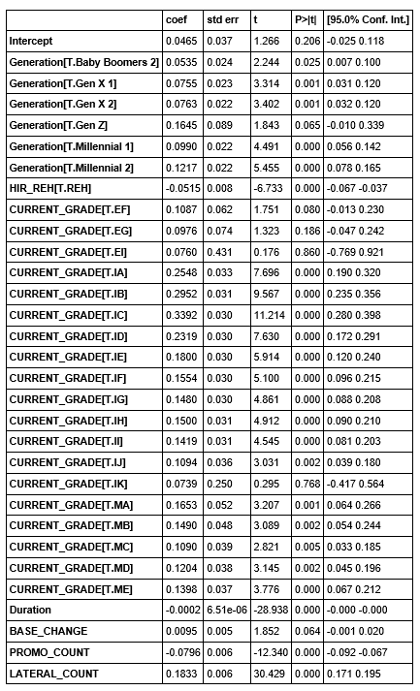
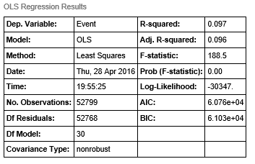
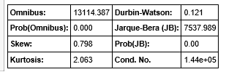
 | coef | std err | t | P>|t| | [95.0% Conf. Int.]
Intercept | 0.0465 | 0.037 | 1.266 | 0.206 | -0.025 0.118
Generation[T.Baby Boomers 2] | 0.0535 | 0.024 | 2.244 | 0.025 | 0.007 0.100
Generation[T.Gen X 1] | 0.0755 | 0.023 | 3.314 | 0.001 | 0.031 0.120
Generation[T.Gen X 2] | 0.0763 | 0.022 | 3.402 | 0.001 | 0.032 0.120
Generation[T.Gen Z] | 0.1645 | 0.089 | 1.843 | 0.065 | -0.010 0.339
Generation[T.Millennial 1] | 0.0990 | 0.022 | 4.491 | 0.000 | 0.056 0.142
Generation[T.Millennial 2] | 0.1217 | 0.022 | 5.455 | 0.000 | 0.078 0.165
HIR_REH[T.REH] | -0.0515 | 0.008 | -6.733 | 0.000 | -0.067 -0.037
CURRENT_GRADE[T.EF] | 0.1087 | 0.062 | 1.751 | 0.080 | -0.013 0.230
CURRENT_GRADE[T.EG] | 0.0976 | 0.074 | 1.323 | 0.186 | -0.047 0.242
CURRENT_GRADE[T.EI] | 0.0760 | 0.431 | 0.176 | 0.860 | -0.769 0.921
CURRENT_GRADE[T.IA] | 0.2548 | 0.033 | 7.696 | 0.000 | 0.190 0.320
CURRENT_GRADE[T.IB] | 0.2952 | 0.031 | 9.567 | 0.000 | 0.235 0.356
CURRENT_GRADE[T.IC] | 0.3392 | 0.030 | 11.214 | 0.000 | 0.280 0.398
CURRENT_GRADE[T.ID] | 0.2319 | 0.030 | 7.630 | 0.000 | 0.172 0.291
CURRENT_GRADE[T.IE] | 0.1800 | 0.030 | 5.914 | 0.000 | 0.120 0.240
CURRENT_GRADE[T.IF] | 0.1554 | 0.030 | 5.100 | 0.000 | 0.096 0.215
CURRENT_GRADE[T.IG] | 0.1480 | 0.030 | 4.861 | 0.000 | 0.088 0.208
CURRENT_GRADE[T.IH] | 0.1500 | 0.031 | 4.912 | 0.000 | 0.090 0.210
CURRENT_GRADE[T.II] | 0.1419 | 0.031 | 4.545 | 0.000 | 0.081 0.203
CURRENT_GRADE[T.IJ] | 0.1094 | 0.036 | 3.031 | 0.002 | 0.039 0.180
CURRENT_GRADE[T.IK] | 0.0739 | 0.250 | 0.295 | 0.768 | -0.417 0.564
CURRENT_GRADE[T.MA] | 0.1653 | 0.052 | 3.207 | 0.001 | 0.064 0.266
CURRENT_GRADE[T.MB] | 0.1490 | 0.048 | 3.089 | 0.002 | 0.054 0.244
CURRENT_GRADE[T.MC] | 0.1090 | 0.039 | 2.821 | 0.005 | 0.033 0.185
CURRENT_GRADE[T.MD] | 0.1204 | 0.038 | 3.145 | 0.002 | 0.045 0.196
CURRENT_GRADE[T.ME] | 0.1398 | 0.037 | 3.776 | 0.000 | 0.067 0.212
Duration | -0.0002 | 6.51e-06 | -28.938 | 0.000 | -0.000 -0.000
BASE_CHANGE | 0.0095 | 0.005 | 1.852 | 0.064 | -0.001 0.020
PROMO_COUNT | -0.0796 | 0.006 | -12.340 | 0.000 | -0.092 -0.067
LATERAL_COUNT | 0.1833 | 0.006 | 30.429 | 0.000 | 0.171 0.195

Slide 11
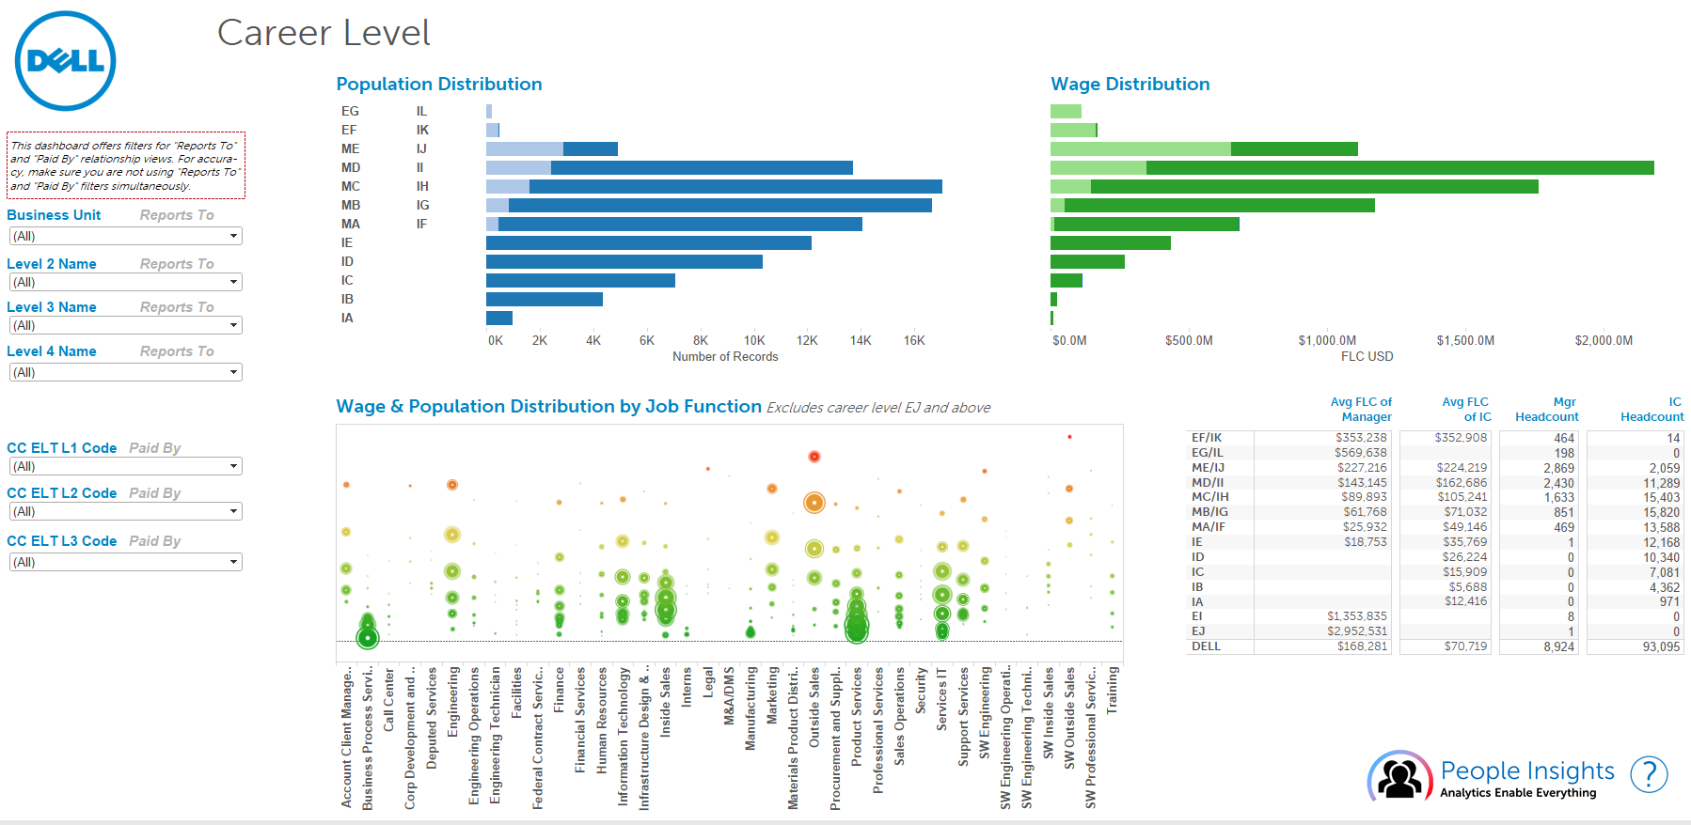

Slide 12
